Slide 1
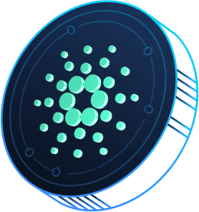
Demystifying Crypto Derivatives
From Basics to Building Blockchain-Based Options

Slide 2

About myself
Dr. Lars Brünjes
Mathematician & Haskell Enthusiast
Director of Education at IOG
CTO at Genius Yield

Slide 3
About myself
Dr. Lars Brünjes
Background in Finance
Director of Education at IOG
CTO at Genius Yield

Slide 4

Traditional Derivatives

Slide 5
“In finance, a derivative is a contract that derives its value from the performance of an underlying entity.”
Wikipedia

Slide 6
Types of Derivatives
Future
Swaps
Options
…
Contracts to buy or sell an asset on a future date at a price specified today.

Slide 7
Types of Derivatives
Future
Swaps
Options
…
Contracts to exchange cash (flows) on or before a specified future date based on the underlying value of currencies exchange rates, bonds/interest rates, commodities exchange, stocks or other assets.

Slide 8
Types of Derivatives
Future
Swaps
Options
…
Contracts that give the owner the right, but not the obligation, to buy [...] or sell [...] an asset. The price at which the sale takes place is known as the strike price, and is specified at the time the parties enter into the option. The option contract also specifies a maturity date. [...] If the owner of the contract exercises this right, the counterparty has the obligation to carry out the transaction.

Slide 9
Call & Put Options
A Call Option gives the owner the right to buy an asset at the strike price at some point in the future.
A Put Option gives the owner the right to sell an asset at the strike price at some point in the future.

Slide 10
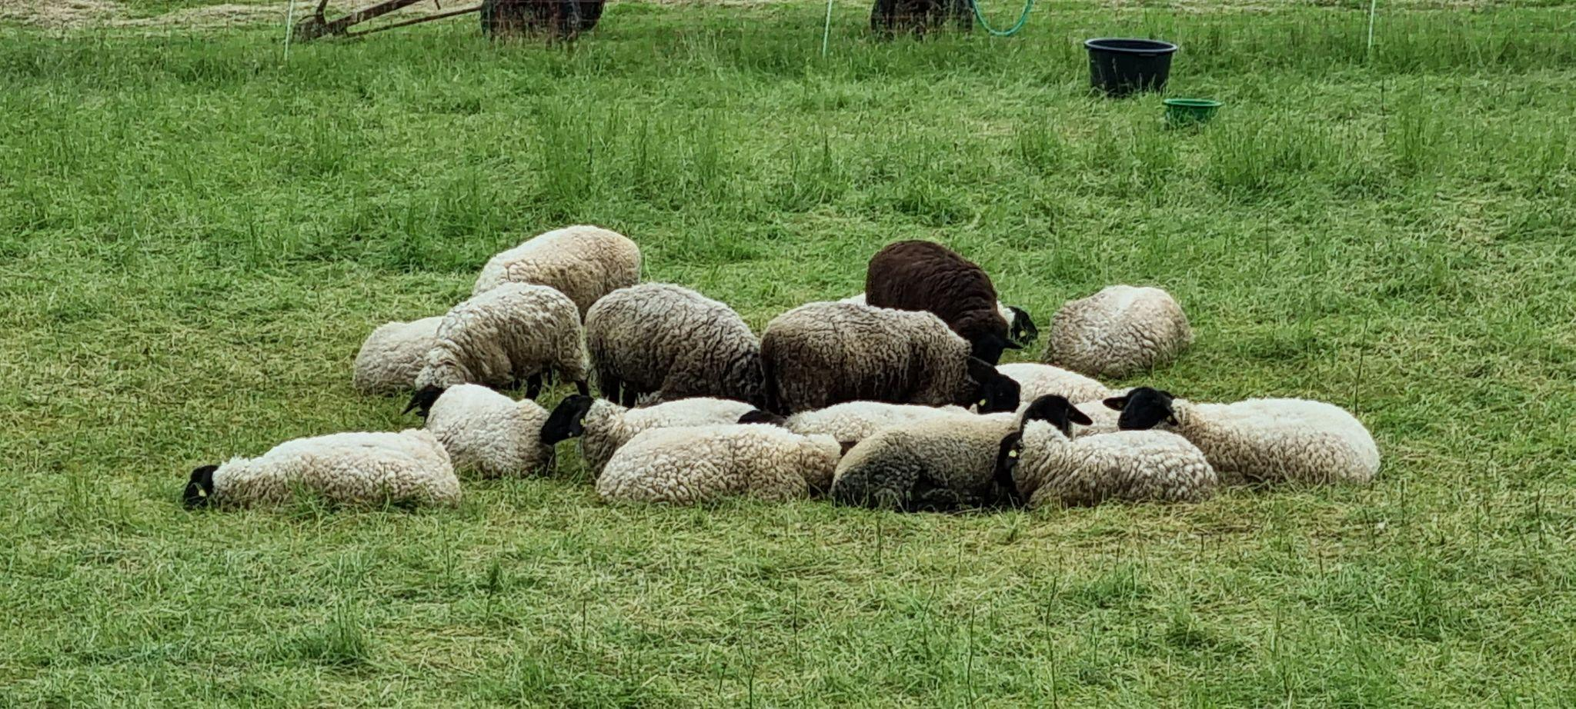
A sheep farmer might buy a Put Option for wool to receive a guaranteed minimum price come shearing time.

Slide 11

A logistics company could buy a Call Option for petrol to hedge against a drastic price increase.

Slide 12
American & European Options
The owner of an American Option can require the sale to take place at any time up to the maturity date.
The owner of a European Option has the right to require the sale to take place on (but not before) the maturity date.

Slide 13

Options on the Blockchain

Slide 14
Opportunities
Get rid of historical ballast:
Number of issued options
Call versus Put
American versus European
Traditionally, options are issued with fixed quantities (like 100). There is no need for that on the blockchain.

Slide 15
Opportunities
Get rid of historical ballast:
Number of issued options
Call versus Put
American versus European
A Call option is just a Put option with the two assets reversed. No need to make that distinction!

Slide 16
Opportunities
Get rid of historical ballast:
Number of issued options
Call versus Put
American versus European
American and European options can both be generalized to having an arbitrary maturity interval.

Slide 17
Challenge
For traditional options, a Clearing House guarantees that options can be executed. There are no clearing houses in the decentralized setting of a blockchain.

Slide 18

Solution
Replace the clearing house with a smart contract into which the issuer deposits enough funds to guarantee option execution.

Slide 19
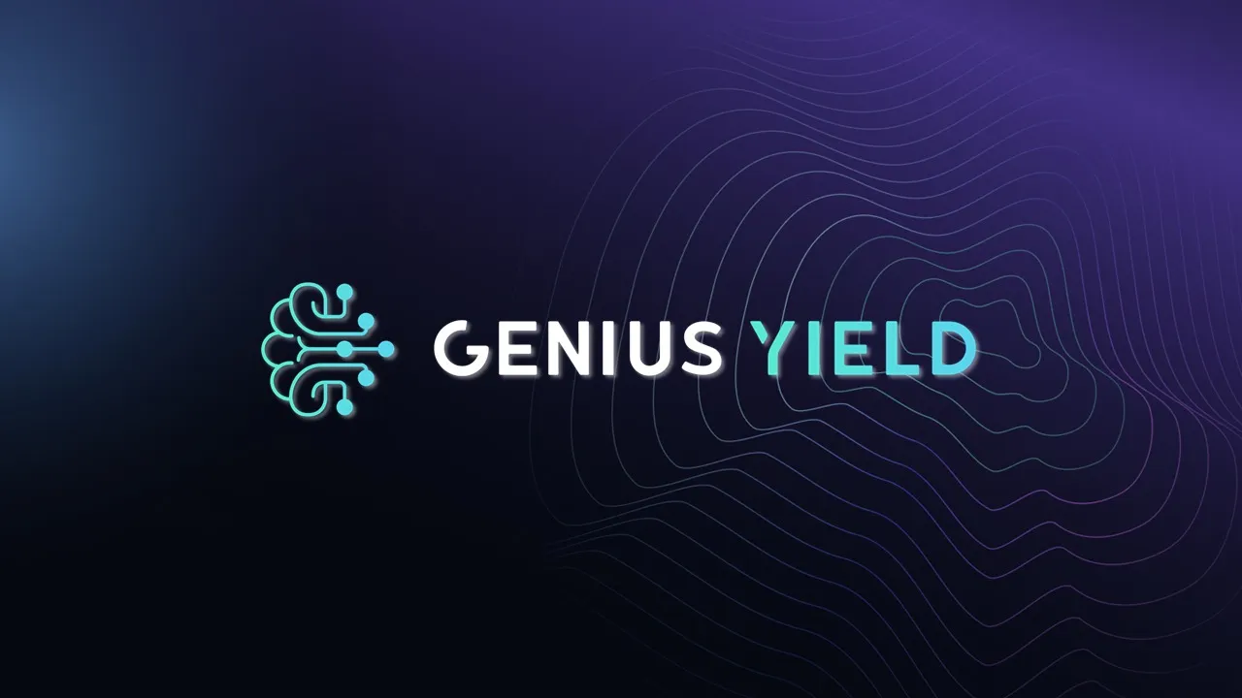
Case Study

Slide 20

Idea
Represent options as Cardano Native Tokens.
Trading of options can then be done on any DEX (or CEX for that matter).

Slide 21
Smart Contracts
Minting Policy
Ensures that when options are minted, the correct deposit is put down.
Deposit Contract
“Identity” tracked by an NFT.
Ensures that options are burnt and the correct price is paid when options are executed.

Slide 22
Example: Minting a GENS Put Option with strike price 2 GENS/ADA and maturity interval 1.12.23 0:00 - 6.12.23 17:00.
Issuer 1000 Options
Issuer 1000 ADA
Tx
Mints 1000 Options & 1 NFT
Deposit Contract 1000 ADA + 1 NFT
2 GENS/ADA 1.12.23 0:00 - 6.12.23 17:00

Slide 23
Executing the option during the maturity interval.
Owner 100 ADA
Owner 100 Options + 200 GENS
Tx
Burns 100 Options
Deposit Contract 1000 ADA + 1 NFT
Deposit Contract 900 ADA + 200 GENS + 1 NFT
2 GENS/ADA 1.12.23 0:00 - 6.12.23 17:00
2 GENS/ADA 1.12.23 0:00 - 6.12.23 17:00

Slide 24
Cancelling the option before or during the maturity interval.
Issuer 150 ADA
Issuer 150 Options
Tx
Burns 150 Options
Deposit Contract 900 ADA + 200 GENS + 1 NFT
Deposit Contract 750 ADA + 200 GENS + 1 NFT
2 GENS/ADA 1.12.23 0:00 - 6.12.23 17:00
2 GENS/ADA 1.12.23 0:00 - 6.12.23 17:00

Slide 25
Retrieving the deposit after the maturity interval.
Deposit Contract 750 ADA + 200 GENS + 1 NFT
Issuer 750 ADA + 200 GENS
Tx
Burns 1 NFT
2 GENS/ADA 1.12.23 0:00 - 6.12.23 17:00

Slide 26
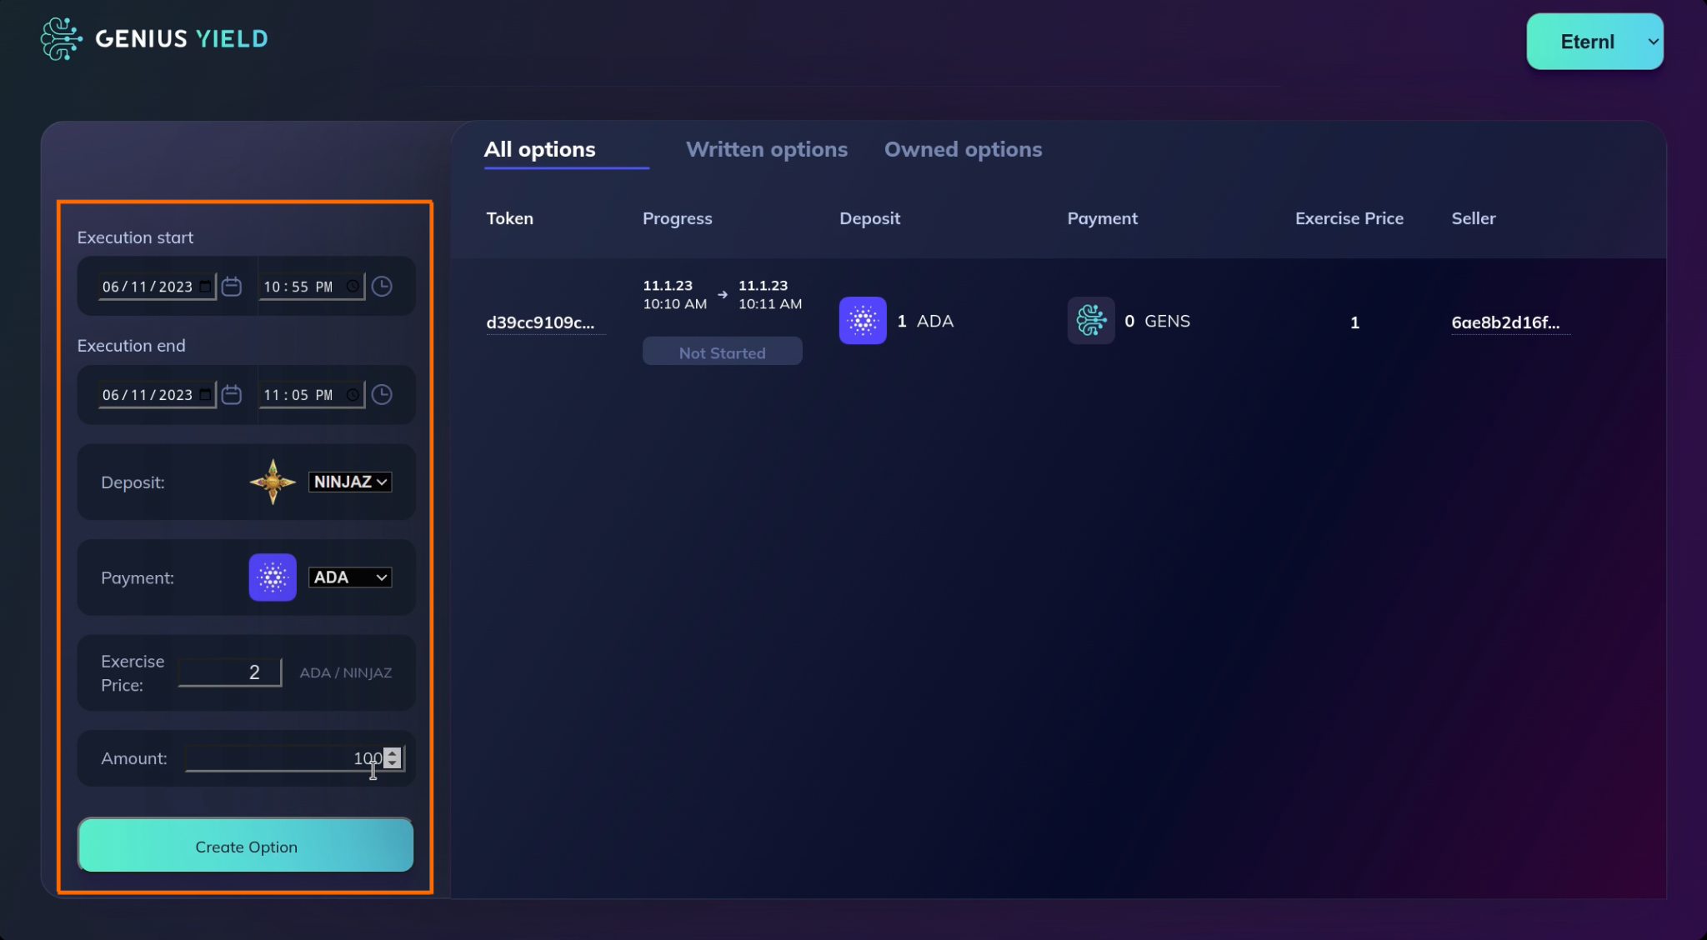
Prototype: Option Creation

Slide 27
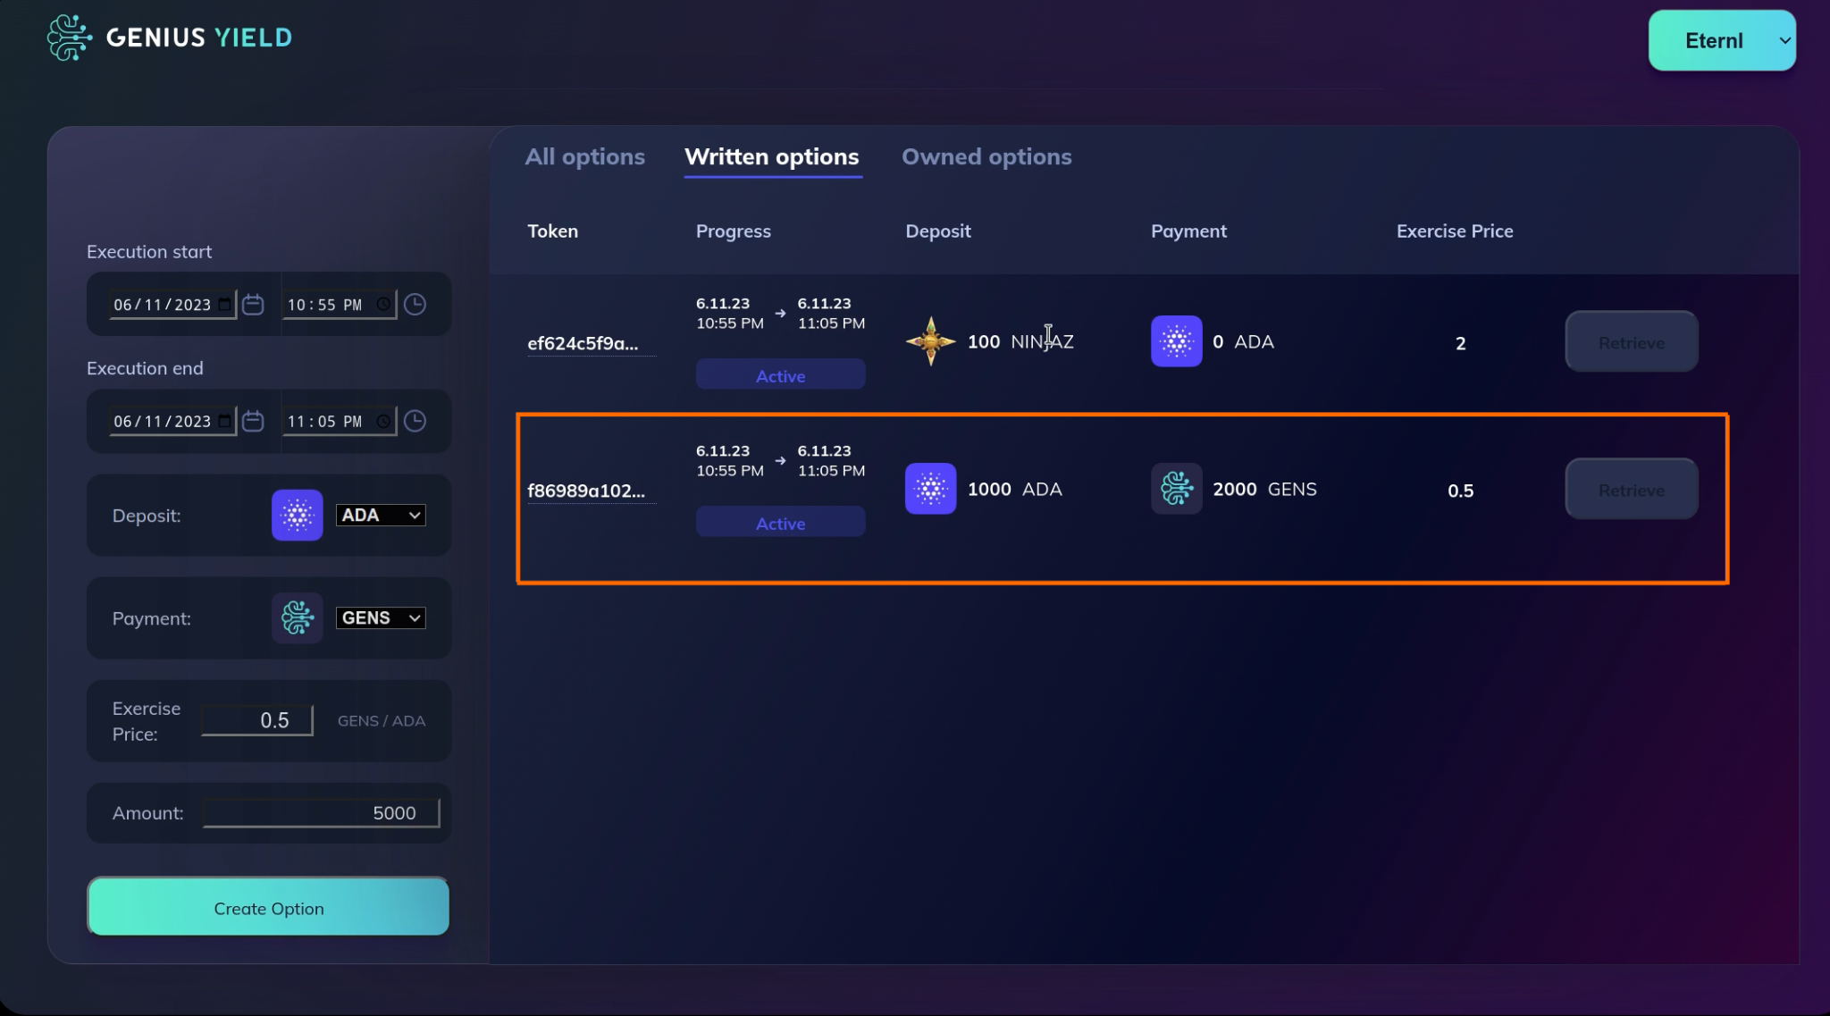
Prototype: Active Option

Slide 28
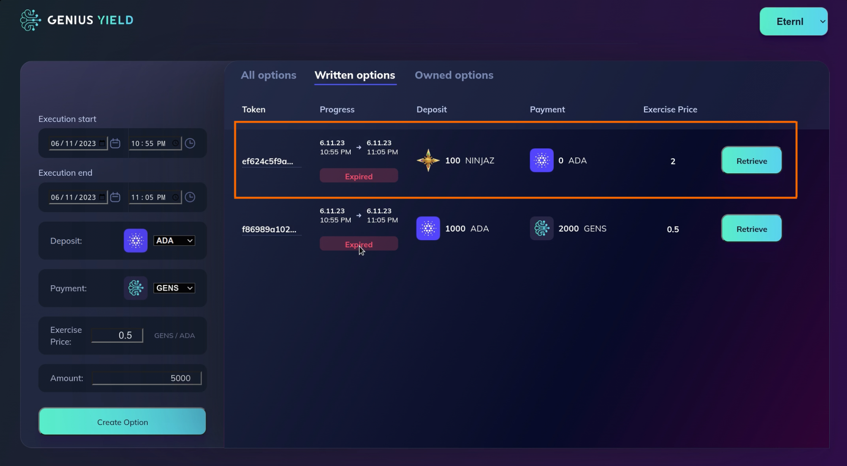
Prototype: Expired Option

Slide 29

Thank you!
Input Output https://iohk.io
Lars.Bruenjes@iohk.io
Genius Yield https://www.geniusyield.co Lars.Bruenjes@geniusyield.co
Twitter
@LarsBrunjes

